Slide 1
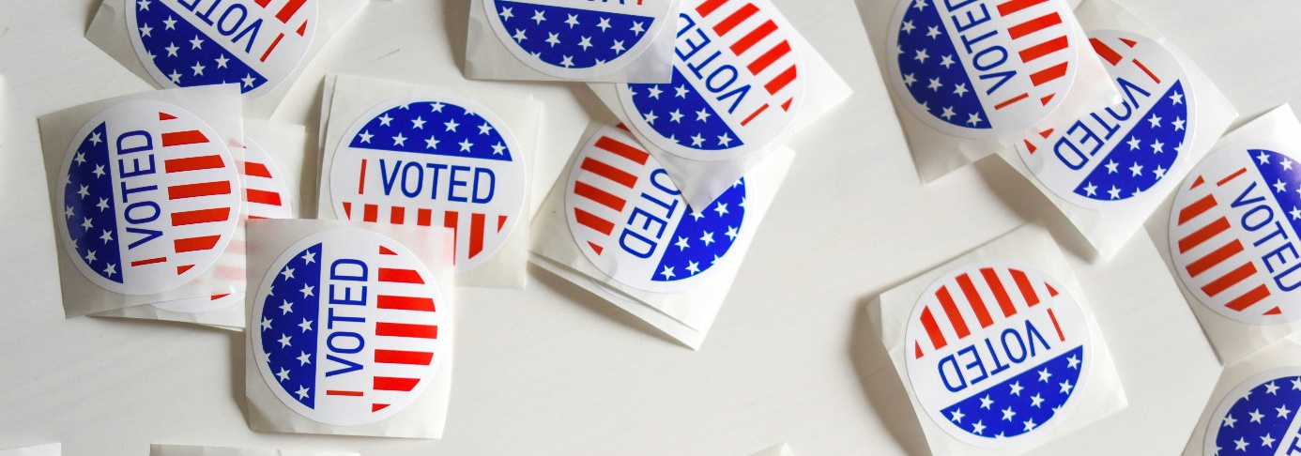
Election 2024

Slide 2
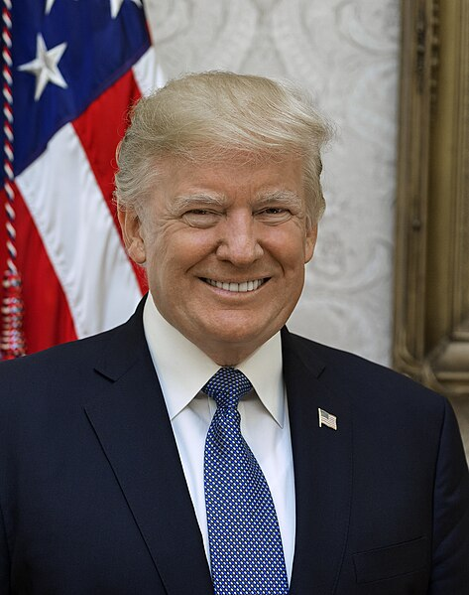
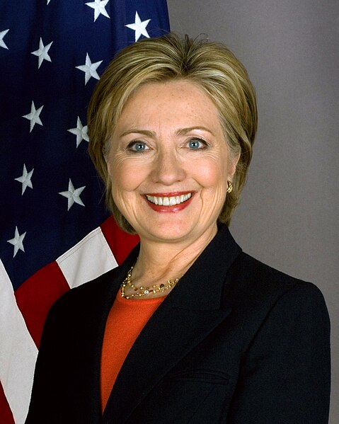
Donald Trump
Hillary Clinton
Republican presidential candidate in 2016
Democratic presidential candidate in 2016

Slide 3
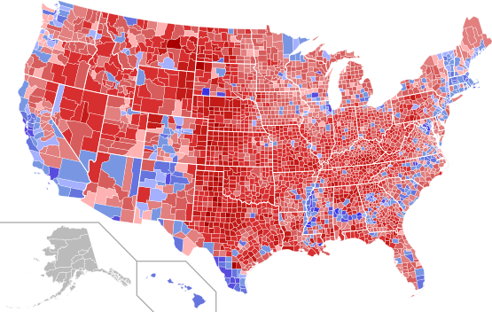
Election 2016
62.984.828 Stimmen
65.853.514 Stimmen

Slide 4
Election 2016
Trump voters 63 millions
Clinton voters 66 millions
Non-voters 100 millions

Slide 5
Donald Trump
Hillary Clinton
Republican presidential candidate in 2016
Democratic presidential candidate in 2016

Slide 6
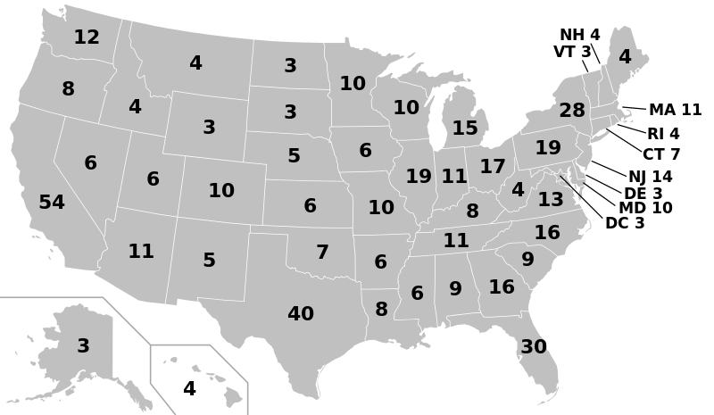
Electoral college 2024
https://creativecommons.org/publicdomain/zero/1.0/deed.en

Slide 7
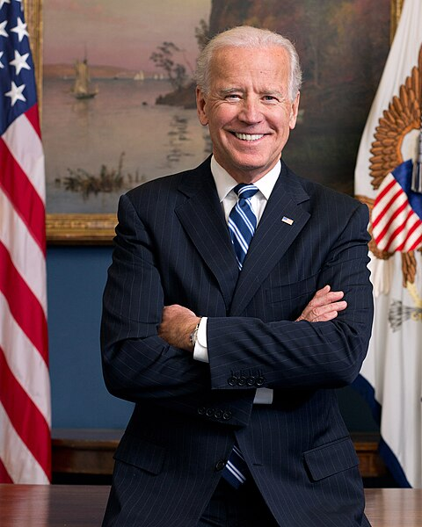
Joe Biden, Democratic presidential candidate

Slide 8
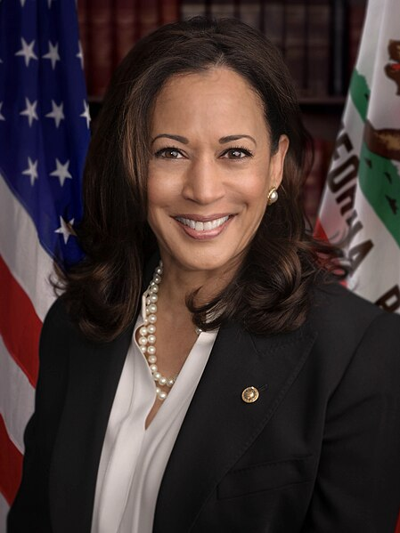
Kamala Harris, Democratic Californian senator, vice presidential nominee

Slide 9
Bildnachweis
Folie 1 Element5Digital on Unsplash
Folie 2f. Hillary Clinton, White House – Public domain / Donald Trump, White House – Public domain
Folie 3 Ergebnisse, Public domain (C0)
Folie 5 Cup, freesvg.org – Public domain
Folie 6 Electoral college 2024, Public domain
Folie 7Joe Biden, White House – Public domain
Folie 8 Kamala Harris, White House – Public domain

